Slide 1
Full EMV and Early/Quick EMV
There are two main types of EMV transaction processing: Full EMV and Quick EMV (also known as Early/Offline/Contactless EMV).
Both are CP(Card Present) Transaction
Full EMV (Online EMV)
In a Full EMV transaction, the cardholder inserts their EMV chip card into a compatible card reader (ATM or point-of-sale terminal). The chip generates a unique transaction code for each transaction, which is then sent to the card issuer's authorization system for approval. The transaction data is encrypted, and the issuer's response is also cryptographically verified. This process ensures the authenticity of the card and reduces the risk of card cloning and data breaches.

Slide 2
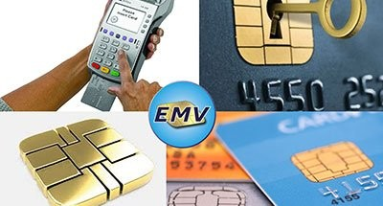
Advantages:
High level of security due to real-time communication with the issuer's authorization system.
Effective against various types of card fraud.
Disadvantages:
Slower transaction process compared to traditional magnetic stripe cards.
Requires an online connection to the issuer's system.

Slide 3
Quick EMV (Early/Offline/Contactless EMV)
Quick EMV refers to transactions where the cardholder can make a payment by simply tapping their EMV chip card or contactless-enabled device (like a smartphone or smartwatch) on a compatible card reader terminal. These transactions are sometimes referred to as "offline" or "contactless" because they don't require an online connection to the card issuer's system during the transaction itself. However, some online connectivity may still be needed periodically to update card data and security parameters.

Slide 4
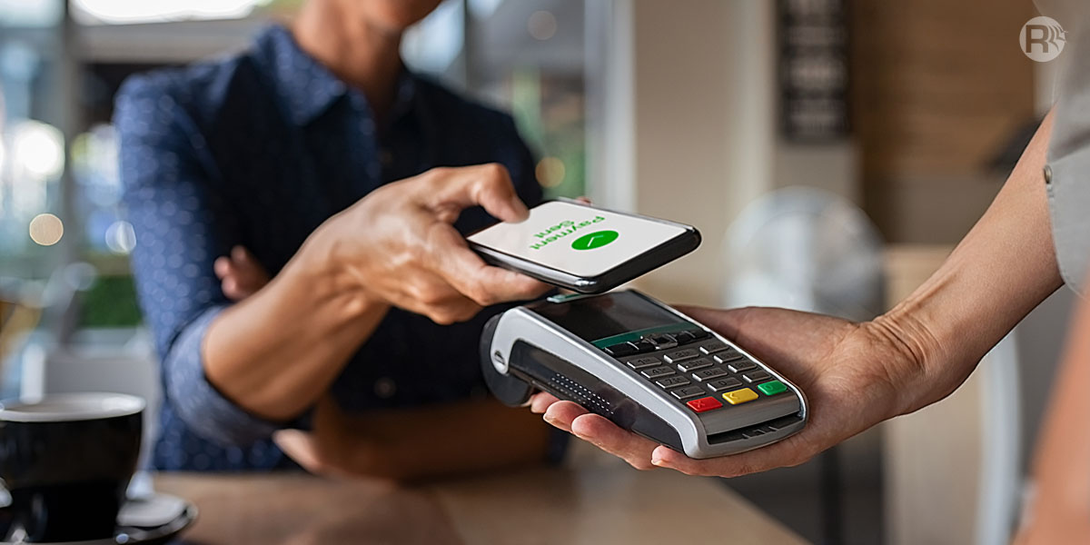
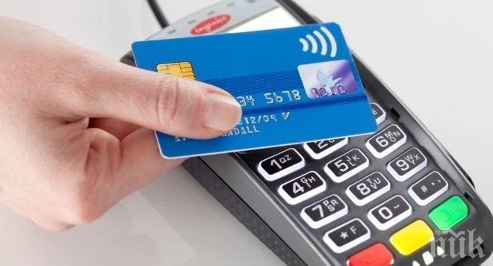
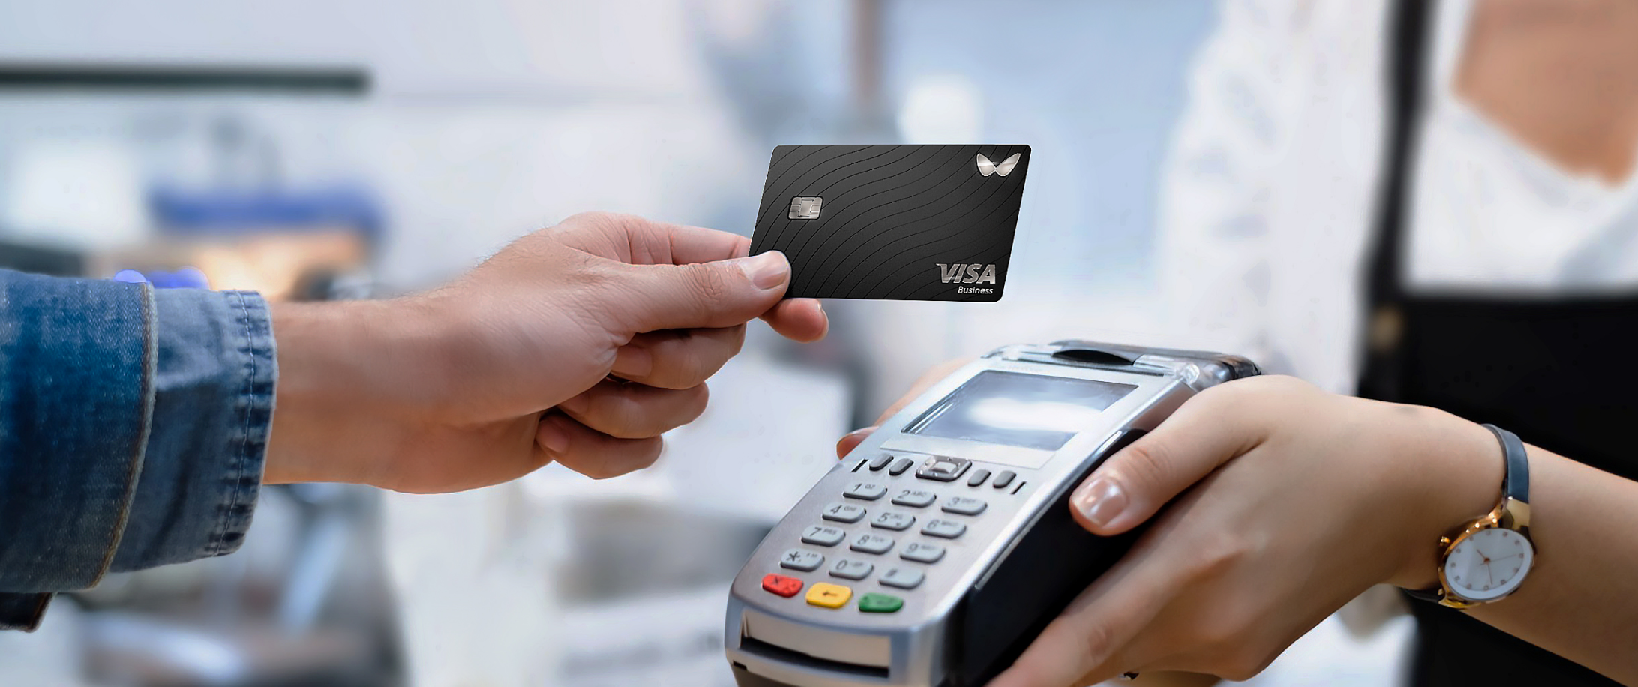
Advantages:
Faster transaction process compared to Full EMV.
Convenient for small-value transactions.
Disadvantages:
Lower security compared to Full EMV because the offline transaction limits the ability to validate the card and transaction data in real time.
Susceptible to certain types of attacks and fraud, such as relay attacks.
NFC Mobile Payment
Tap and go
RFID

